Slide 1
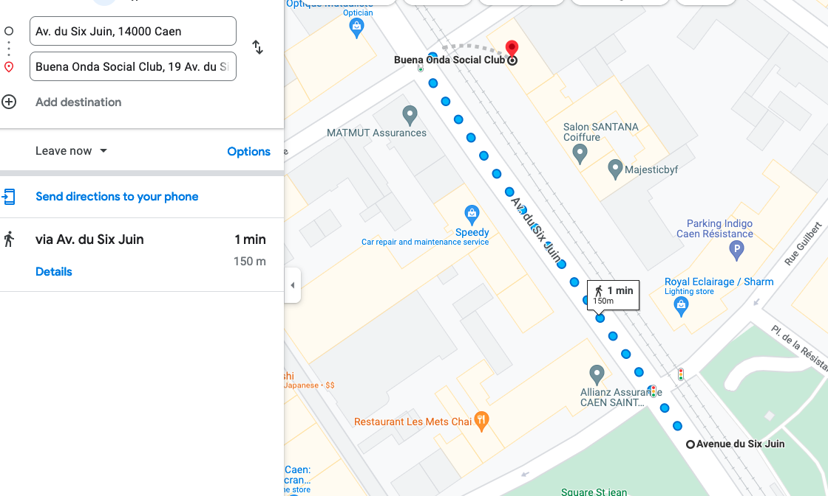
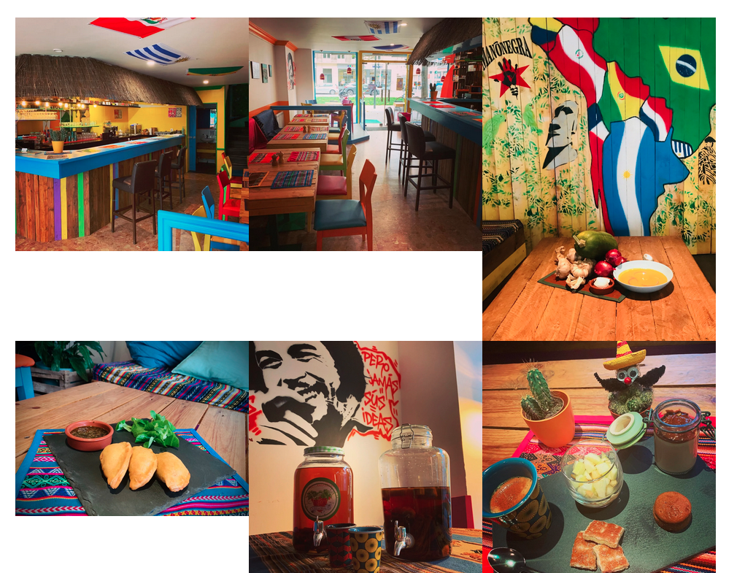
Tuesday from 20:00 to 1:00
Bar tapas
Maximum 40 people
Tram Stop: Av. Six Juin

